Slide 1
seGuRo Drive
SivaKUMAR pothala
KARTHIK REPALA
SURENDRA Koripella

Slide 2
Motivation
Advancements in the today's mobile technology created a huge scope to develop applications that are beneficial to the users.
Now-a-days Due to rapid increase in number of vehicles, it is essential to track fuel expenses to save users wallet.
It is hard to locate user’s vehicle when parked in huge garages.
Many applications were designed to provide specific feature but not all services in single application.

Slide 3
Objectives
One stop solution for multiple services
Tracking Fuel expenses
Directions from User’s current location to Parked Vehicle location
Weather updates
Navigation directions from one location to other location

Slide 4
Proposed Solutions
First Users have to register into the app
User should input vehicle Make, Year, Model, Odometer reading, Fuel level, Fuel price to see cost of a trip and fuel performance charts
User has to input source and destination to get Navigation directions
User can find weather updates for any location by giving city name
User can mark the location while parking the car, When User wants to find the parked car by using “where is my car” service.

Slide 5
Features
Fuel Log (Check Fuel Expenses)
Weather Service
Navigation Service
Where is my Car

Slide 6
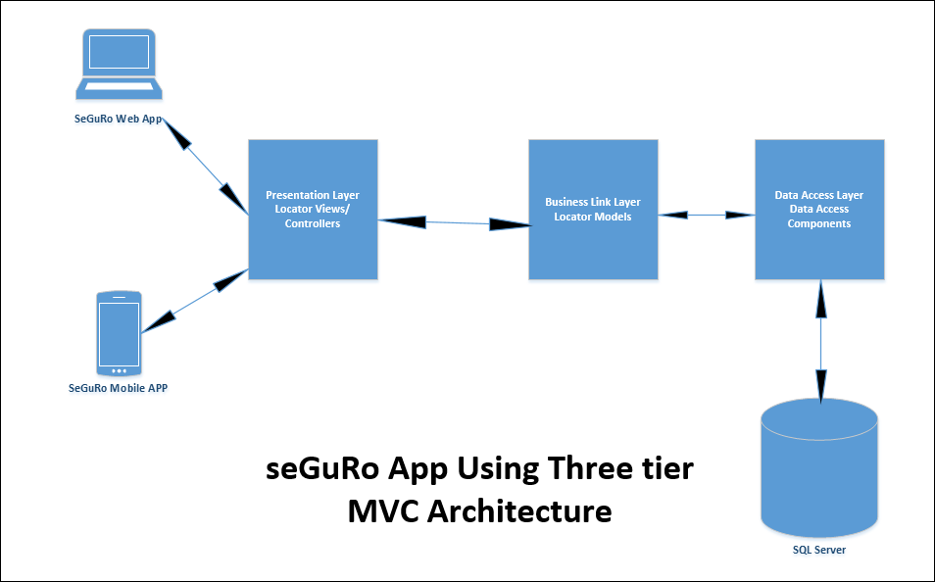
System Architecture & Implementation

Slide 7
Technologies Used:
ASP .NET
JQUERY
HTML5
CSS

Slide 8
Evaluation
Significance:
Seguro Drive Application changes bad driving habits and helps in finding parked vehicle.
Individual data is protected by User Authentication.
This application is developed by using mobile and web technologies, so it is compatible with all mobile and web platforms.

Slide 9
Evaluation
Uniqueness:
One stop solution for multiple services for a chauffer.
Visual representations of average miles per a gallon
Comparisons with the estimated MPG for City, freeway drive and combination.
Navigation to find a vehicle
Limitation:
User can only store one car per profile in Fuel Services

Slide 10
Thanks Note
Instructor: Prof. Dr. Yugyung Lee
TA: Feichen Shen
IBM Smart Cloud Enterprise Program

Slide 11

Questions

Slide 12


